Slide 1

Bank Customer Churn: Understanding & Reducing Customer Loss
Presented by :-
•Chandan Kumar
• Vivek Kumar
• Dev Brot
• Ayushi Singh

Slide 2

Why Customer Churn Matters in Banking
Significant Revenue Impact
High Acquisition Costs
Acquiring a new customer is 5-6 times more expensive than retaining an existing one, making retention a critical financial priority.
Financial services face an average churn rate of 19%, directly impacting revenue streams and hindering growth potential.
Long-term Value
Loyal, long-term customers not only generate higher profits but also become valuable advocates through referrals, strengthening the bank's market position.

Slide 3

What is Customer Churn?
Customer churn refers to the phenomenon where clients end their relationship with a bank or significantly reduce their engagement with its services.
It is typically measured as the percentage of customers lost over a specific period (e.g., 20% annual churn means one in five customers leaves the bank yearly).
A high churn rate often signals underlying issues such as customer dissatisfaction, intense competitive threats, or deficiencies in service quality.

Slide 4




Key Drivers of Bank Customer Churn
Fees & Charges
Unexpected or excessive fees (ATM, overdraft, paper statements) are a major source of customer dissatisfaction.
Customer Experience
Long wait times, a lack of seamless digital access, and inconsistent service quality drive customers away.
Product Complexity
Paradoxically, customers with a high number of products (e.g., four or more) exhibit significantly higher churn rates, sometimes approaching 100%.
Competitive Landscape
The rise of fintech disruptors offering superior digital experiences and innovative services poses a significant threat to traditional banks.

Slide 5










Data Insights from a 10,000-Customer Dataset
Overall Churn Rate
Geographical Trends
Gender Distribution
A notable 20.4% churn rate, indicating 2,037 customers were lost from the dataset.
50% of customers are based in France, with significant regional variations in churn behavior.
The gender split is nearly even, suggesting churn is not strongly correlated with gender.
Activity Status
Credit Card Ownership
Inactive members show a higher propensity to churn compared to active customers.
Customers holding credit cards tend to have higher churn rates than those without.

Slide 6

Predictive Modeling for Churn Detection
Advanced machine learning models are employed to predict which customers are at risk of churning.
Logistic Regression
Decision Trees
Neural Networks
Key predictors include: Age, Tenure, Account Balance, Number of Products held, and Activity Status.
For example, customers managing four or more bank products face a nearly 100% churn risk, highlighting a critical pain point.
Early identification allows banks to deploy targeted retention campaigns, preventing customer loss before it occurs.

Slide 7

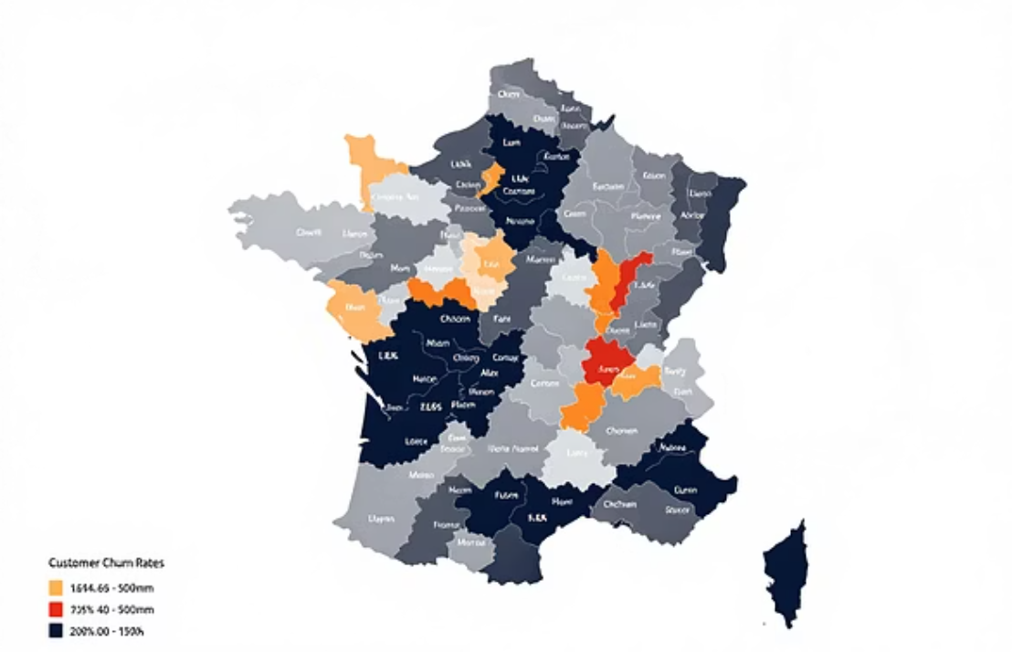
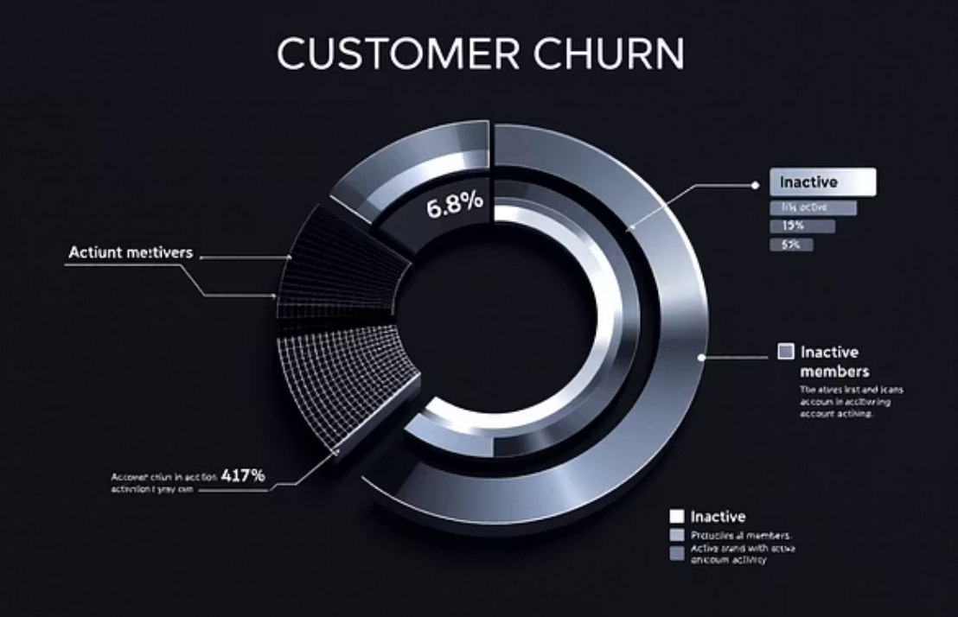
Visualizing Churn Patterns
These visualizations offer actionable insights into customer behavior, helping to pinpoint specific segments and factors driving churn.

Slide 8

Strategies to Reduce Bank Customer Churn
01
Simplify & Educate
Streamline product offerings and provide clear, comprehensive education on product usage and benefits.
02
Enhance Experience
Invest in robust digital banking platforms and ensure highly responsive customer service channels.
03
Targeted Retention
Develop tailored retention strategies for high-risk customer segments, such as inactive users or those with multiple products.
04
Proactive Engagement
Leverage predictive analytics to identify and engage at-risk customers proactively with personalized offers and support.

Slide 9

Case Study: Proactive Retention Success
Bank X achieved a remarkable reduction in churn from 22% to 15% within a single year by implementing strategic initiatives:
Machine Learning Prediction: Adopted advanced machine learning models to accurately predict customer churn risks.
Personalized Offers: Launched customized offers and incentives specifically targeting customers with multiple products, addressing a key churn driver.
Improved Support: Enhanced onboarding processes and strengthened digital support channels, leading to a smoother customer experience.

Slide 10








Conclusion: Turning Churn into Opportunity
Understand Drivers
Act Early
Recognizing churn drivers is fundamental to fostering customer loyalty and ensuring long-term profitability.
Data-driven insights and predictive models empower banks to intervene proactively, transforming potential losses into retained customers.
Build Lasting Relationships
Focus Retention
The ultimate goal is to cultivate smarter, more enduring banking relationships that benefit both the customer and the institution.
Implementing focused retention strategies can convert the threat of churn into significant growth opportunities.

